Slide 1
Process Synchronization

Slide 2
Process Synchronization
Background and Race conditions
The Critical-Section Problem
Simple Solutions
Solutions using Synchronization Hardware
Semaphores
Solutions of Classic Problems of Synchronization

Slide 3
Background
Cooperating Processes
  Processes that can affect or be affected by other processes
  Implementation uses shared logical address space or shared data using files
Concurrent access to shared data may result in data inconsistency
Maintaining data consistency requires mechanisms to ensure the orderly execution of cooperating processes

Slide 4
Process Interactions
Processes may interact in four different ways:
Sharing of data – Data consistency should be preserved
Synchronization of actions– Processes should perform their actions in a desired order
Passing of messages – Messages should be stored and delivered appropriately
Sending of Signals – Processes should be able to send signals to other processes and specify signal handling actions when signals are sent to them
The OS performs message passing and provides facilities
for the other three modes of interaction

Slide 5
Interacting processes
Definition: Processes P_{i}, P_{j} interact if
  read_set_{i} ∩ write_set_{j} ≠ Ø or write_set_{i} ∩ read_set_{j} ≠ Ø, where
  Read-set : Set of variables merely read by a process
  Write-set : Set of variables read and written to by a process
Non-interacting processes are independent processes
  Data access synchronization
    Avoiding race conditions through mutual exclusion
  Control synchronization
    Ensuring that processes perform operations in a desired sequence

Slide 6
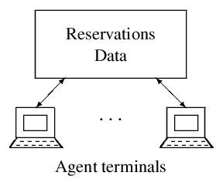
An example of data sharing: airline reservations

Slide 7
Race conditions in data sharing
Results of operations performed on shared data may be
wrong if race conditions exist. Let us see why this may be
so
Let operations O_{i} and O_{j} update value of a shared data d, let f_{i}(d) and f_{j}(d) represent the value of d after the operations
If processes P_{i} and P_{j} perform operations O_{i} and O_{j}
  If O_{i} is performed before Oj, resulting value of d is fi(fj(d))
  If Oj is performed before Oi, resulting value of d is fj(fi(d))

Slide 8
Race conditions in data sharing
A race condition is a situation in which the result of performing operations Oi and Oj in two processes is neither fi(fj(d)) nor fj(fi(d)).
Q: Why do race conditions exist?

Slide 9
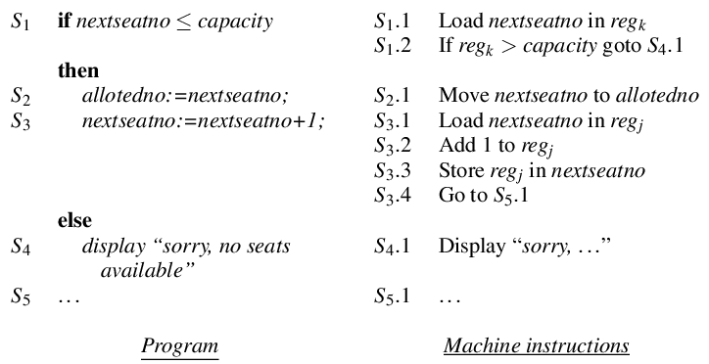
Data sharing by processes of a reservations system

Slide 10
Race condition in the airline reservations system
Race conditions in the airline reservations system may have two consequences:
  nextseatno may not be updated properly
  Same seat number may be allocated to two passengers

Slide 11
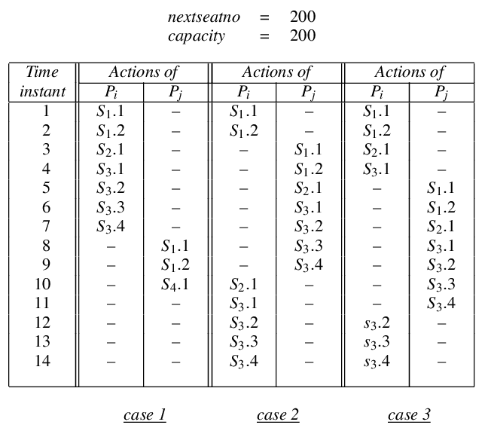
Race conditions in the airline reservations system

Slide 12
Critical Section (CS)
A critical section (CS) for a data item d_{s} is a section of code that cannot be executed concurrently with itself or with another critical section for d_{s}
  We will use the graphic notation of a rectangular box in code to depict a critical section (see next slide)
Consistency of a shared data d_{s} is protected by enclosing all uses of d_{s} within critical sections

Slide 13
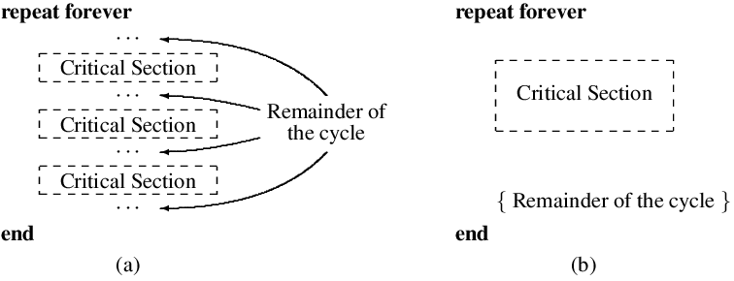
(a) A process with many critical sections,
(b) A simpler way of depicting this process.

Slide 14
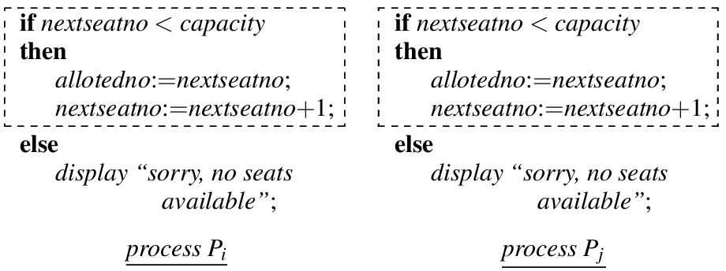
Use of CS in airline reservation to avoid race conditions

Slide 15
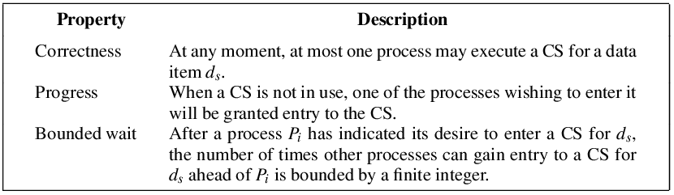
Essential properties of a CS implementation

Slide 16
Busy wait
To implement a CS, a process should check whether some other process is in its CS
A busy wait is a situation in which a process checks a condition over and over again until it is satisfied, e.g.,
while {some processes is in a CS for d_{s}}
{ do nothing}
{ CS}
  A busy wait wastes CPU power
  It also leads to priority inversion
    A high priority process is blocked
    A low priority process is scheduled and gets into a CS for a data item d_{s}
    The high priority process become active but cannot enter a CS for d_{s}
    Both processes wait indefinitely

Slide 17
Busy wait
The Priority inheritance protocol is used to avoid the problem of priority inversion
    A low priority process holding a resource inherits priority of a high priority process that is waiting for the resource
    It enables the low priority process to complete use of the CS

Slide 18
Control Synchronization
The key issue in control synchronization is that a process should perform some action only after some other processes have performed specific actions
  How to know whether another process has performed a specific operation?
  We need a signaling arrangement for this
    Next slide shows a signaling arrangement using boolean variables
    If variables are used for signaling, could there be race conditions?
  We also require the kernel to provide blocking and activation of processes when desired

Slide 19
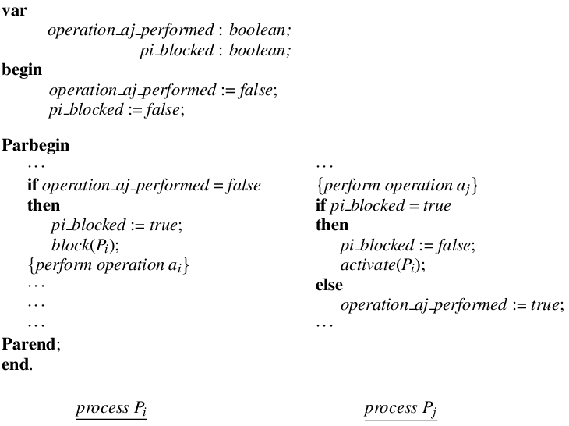
An attempt at signaling through boolean variables

Slide 20
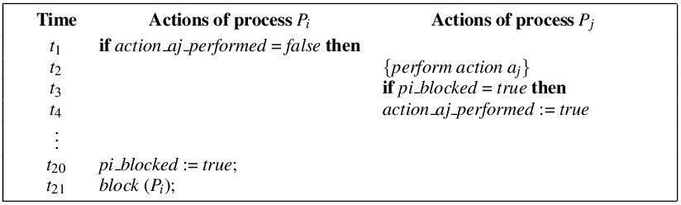
Race condition in process synchronization

Slide 21
Avoiding race conditions in process synchronization
Race condition of previous slide:
  When process P_{i} found action_aj_performed was false, it decided to
    Set pi_blocked to true and
    Block itself
  However, P_{j} modified action_aj_performed before P_{i} could perform its actions
Hence all of P_{i}’s actions mentioned above should be performed before P_{j} can modify action_aj_performed
This is achieved through an indivisible operation

Slide 22
Indivisible operation
An indivisible operation on a set of data items {d_{s}} is an operation that cannot be executed concurrently with any other operation involving a data item included in {d_{s}}
  How are indivisible operations implemented? We will see that later
We define two indivisible operations
  Check_aj: If action_aj_performed is false, it sets pi_blocked to true and blocks P_{i}
  Post_aj:
  Q: What actions should it perform?

Slide 23
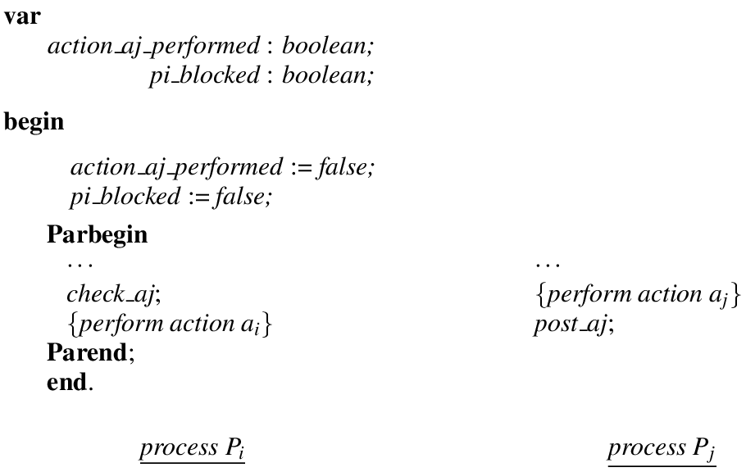
Control synchronization by signaling using indivisible operations

Slide 24
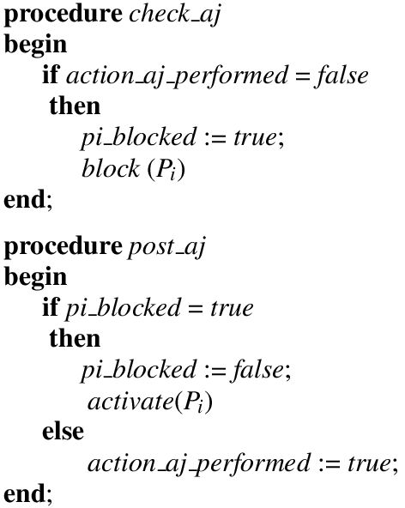
Indivisible operations for signaling

Slide 25
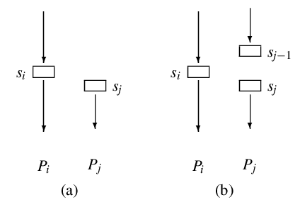
Control synchronization between processes:
Operation s_{j} should be performed after s_{i}

Slide 26
Implementing a critical section or an indivisible operation
Associate a lock variable, which is a boolean variable, with a CS or with an indivisible operation
  A process must not perform a CS or indivisible operation if the lock is already set
  If not, it should set the lock and perform the CS or indivisible operation
Q: Could there be race conditions on the lock variable?
A: Yes. These are avoided through indivisible instructions.

Slide 27
Indivisible instructions
An indivisible instruction is one whose execution cannot be overlapped with execution of any other instruction
  It is useful in avoiding race conditions
Q: How?
Some examples: Test-and-set, atomic swap,
compare and swap

Slide 28
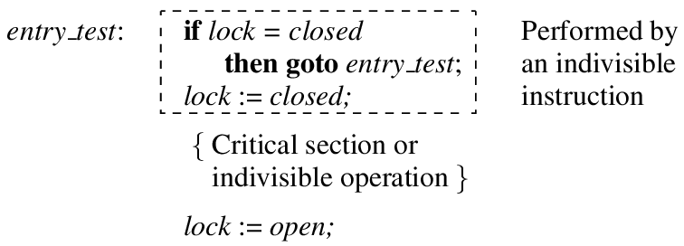
Implementing a critical section operation using a lock variable

Slide 29
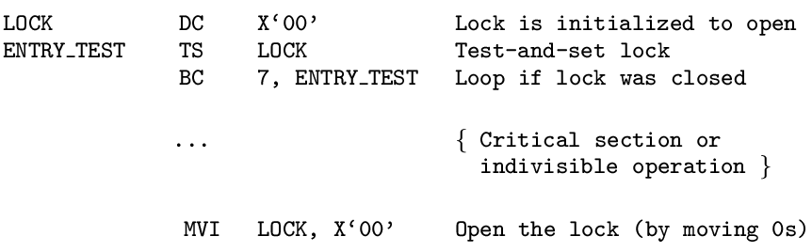
Implementing a critical section or indivisible operation using Test-and-set

Slide 30
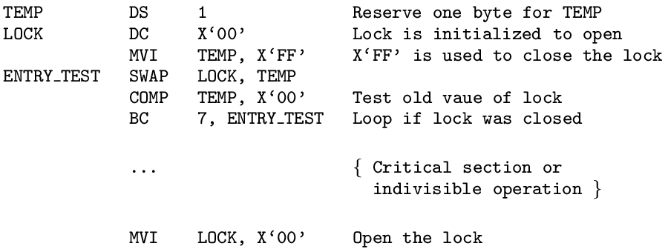
Implementing a critical section or indivisible operation using a swap instruction

Slide 31
Part II : Classic process of synchronization Problems

Slide 32
Solution to critical section problem
Critical Section
  segment of code where shared variables are used
Solution must satisfy the following criteria
Correctness
Maximum Concurrency
No Busy waits

Slide 33
Semaphore
Synchronization tool that does not require busy waiting
Semaphore S – integer variable
Two standard operations modify S: wait() and signal()
  Originally called P() and V()
  signal (S) {
  S++;
  }
wait (S) {
while (S <= 0)
; // no-op
S--;
}
Less complicated
Can only be accessed via two indivisible (atomic) operations

Slide 34
Semaphore as Synchronization Tool
Provides mutual exclusion
  Semaphore S; // initialized to 1
  wait (S);
  Critical Section
  signal (S);
Binary semaphore – integer value can range only between 0 and 1; can be simpler to implement
  Also known as mutex, locks
Counting semaphore – integer value can range over an unrestricted domain
Counting semaphore S can be implemented a as a binary semaphore

Slide 35
Solution of other Synchronization Problem
Two processes P1 and P₂ are running concurrently: P₁ with a statement S₁ and P₂ with a statement S₂
Requirement:
  S₂ be executed only after S₁
Solution:
  Use a a semaphore variable sync initialized to 0
  … …
  S₁ wait(sync)
  signal(sync) S₂
  … …
  Process P₁ Process P₂

Slide 36
Semaphore Implementation
Must guarantee that no two processes can execute wait () and signal () on the same semaphore at the same time
Thus, implementation becomes the critical section problem where the wait and signal code are placed in the critical section.
  Could now have busy waiting in critical section implementation
    But implementation code is short
    Little busy waiting if critical section rarely occupied
Note that applications may spend lots of time in critical sections and therefore this is not a good solution.

Slide 37
Implementation without busy waiting
There is a waiting queue associated with each semaphore.
Each entry in a waiting queue has two data items:
  value (of type integer)
  a list of processes L waiting on this semaphore
  Typical example
  struct Semaphore {
  int value;
  ListOfProcess L;
  };
Two operations on process:
  block – place the process invoking the operation on the appropriate waiting queue.
  wakeup – remove one of processes in the waiting queue and place it in the ready queue.

Slide 38
Implementation without busy waiting
Implementation of wait:
  wait (s) {
  s.value--;
  if (s.value < 0) {
  add this process to waiting queue
  block();
  }
  }
Implementation of signal:
  signal (s) {
  s.value++;
  if (s.value <= 0) {
  remove a process P from the waiting queue
  wakeup(P);
  }
  }

Slide 39
Deadlock and Starvation
Deadlock – two or more processes are waiting indefinitely for an event that can be caused by only one of the waiting processes
Let S and Q be two semaphores initialized to 1
    P₀ P₁
wait (S); wait (Q);
wait (Q); wait (S);
. .
. .
. .
signal (S); signal (Q);
signal (Q); signal (S);
Starvation – indefinite blocking. A process may never be removed from the semaphore queue in which it is suspended.

Slide 40
Classical Problem of Synchronization
Bounded-Buffer Problem
  Producers produce information in a finite set of buffers; consumers consume the information.
  Goal: Smoothen out occassional mismatch of produce and consume rates
Readers and Writers Problem
  Some processes merely read some data, some others modify the data.
  Goal: Ensure consistency of data
Dining-Philosophers Problem
  Adjoining philosophers have to share forks with their neighbours.
  Goal: Ensure that they may eat without indefinite wait for forks

Slide 41
Bounded-Buffer Problem
Producer Cosumer processes with unspecified number
A producer must not write a full buffer
A consumer must not consume an empty buffer
Producers and consumers must access buffers in a mutually exclusive manner.
N buffers, each can hold one item
Optional condition:
  Information must be consumed in the same order in which it is created, i.e. in FIFO order

Slide 42
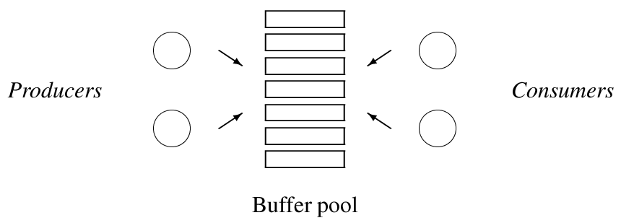
Producers and consumers

Slide 43
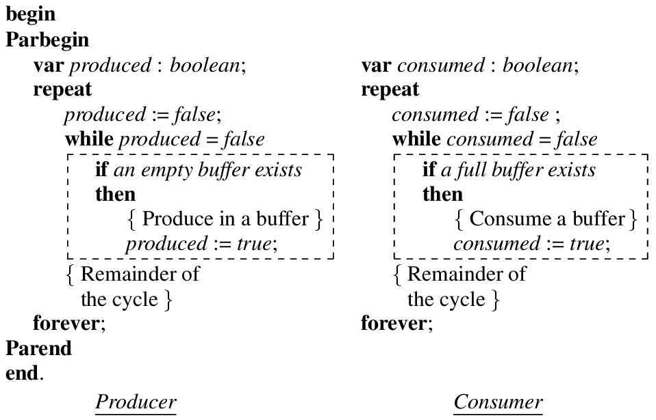
Solution outline for producers-consumers
(contains busy waits)

Slide 44
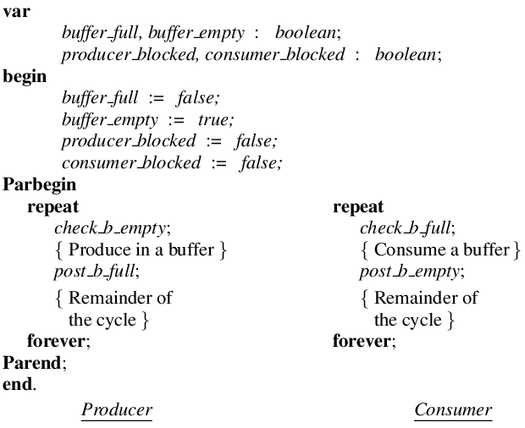
An improved outline for a simple producers-consumers system using signaling

Slide 45
Readers-Writers Problem
A data set is shared among a number of concurrent processes
  Readers – only read the data set; they do not perform any updates
  Writers – can both read and write.
Problem – allow multiple readers to read at the same time. Only one writer can access the shared data at the same time.

Slide 46
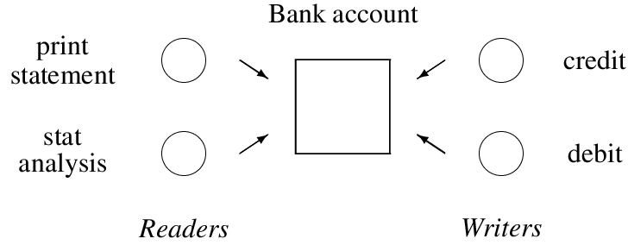
Readers and writers in a banking system

Slide 47
Readers and writers
Many readers may perform reading concurrently
Reading is prohibited while a writer is writing
Only one writer can perform writing
Optional condition:
  A writer should have priority over readers

Slide 48
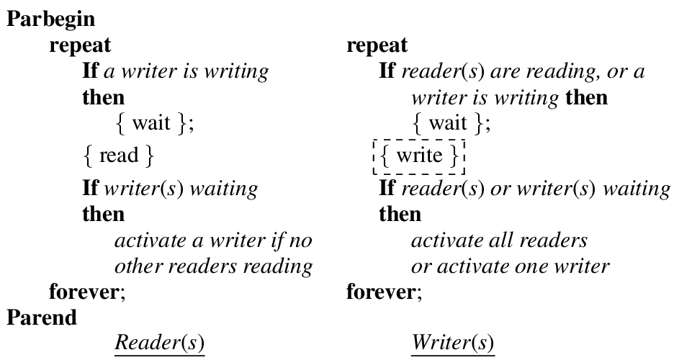
Solution outline for readers-writers without writer priority

Slide 49
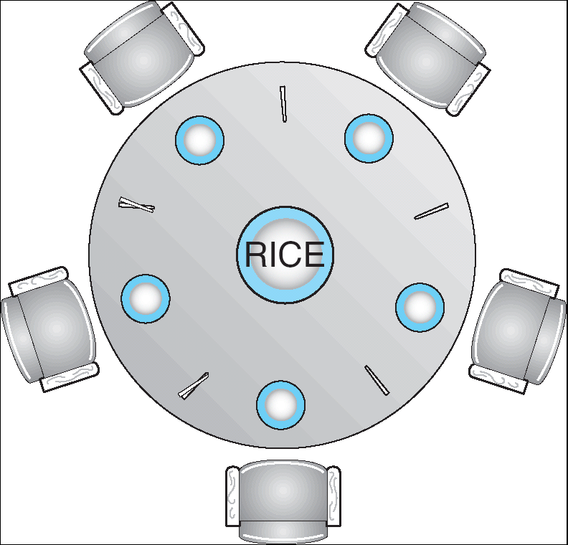
Dining-Philosophers Problem
Shared data
  Bowl of rice (data set) shared by 5 philosophers
  A fork is placed between each pair of philosophers
  To eat each philosopher must pick up two forks from left & right.
  Problem : A hungry philosopher should not face indefinite waits.

Slide 50
Dining-Philosophers Solution
Repeat
if left fork is not available
then
block (Pi);
Lift left fork;
if right fork is not available
then
block (Pi);
Lift right fork;
{eat}
If left neighbor is waiting for his right fork
then
activate (left neighbor );
If right neighbor is waiting for his left fork
then
activate (right neighbor );
{ think}
forever

Slide 51
Problem
If all philosophers simultaneously lift their left forks, none will be able to lift the right fork !ighe
Race condition can also come, because neighbors might fight over a shared fork.
We can avoid deadlocks, by modifying the process of allocation , so that if the right fork is not available , the philosopher would defer to his left neighbor by puttinf down the left fork and repeating the attempt to take the forks some time later.

Slide 52
Solution outline for dining philosophers
Repeat
successful:= false;
While (not successful)
if both forks are available then
lift the forks one at at a time;
successful:= true;
if successful:= false
then
block (Pi);
{eat}
Put down both the forks;
If left neighbor is waiting for his right fork
then
activate (left neighbor );
If right neighbor is waiting for his left fork
then
activate (right neighbor );
{ think}
forever

